Slide 1



Hosting The Olympics
Factors to Consider
Project Group Members
Ariel Dunn
Irina Fedorova
Rachel Newberry

Slide 2
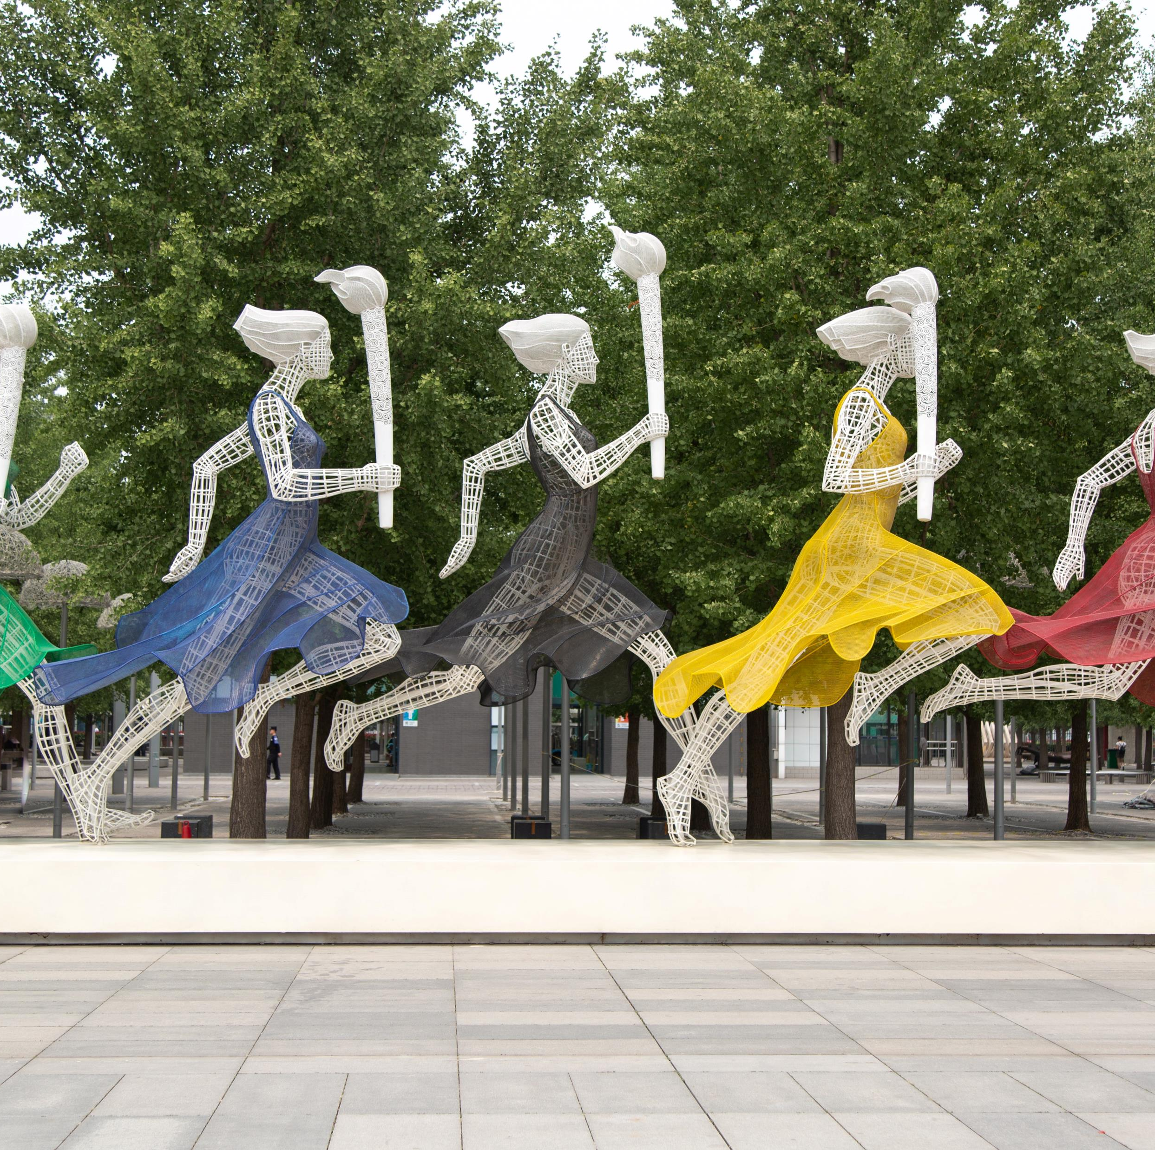

Agenda
Theme ~ Olympic Case Study
Coding Approach
Data Munging Techniques
Client Portal
Dashboard
Plotly ~ Medal Count
Plotly ~ Female Stats
Leaflet Map
Costs
Sports
Questions & Answers

Slide 3
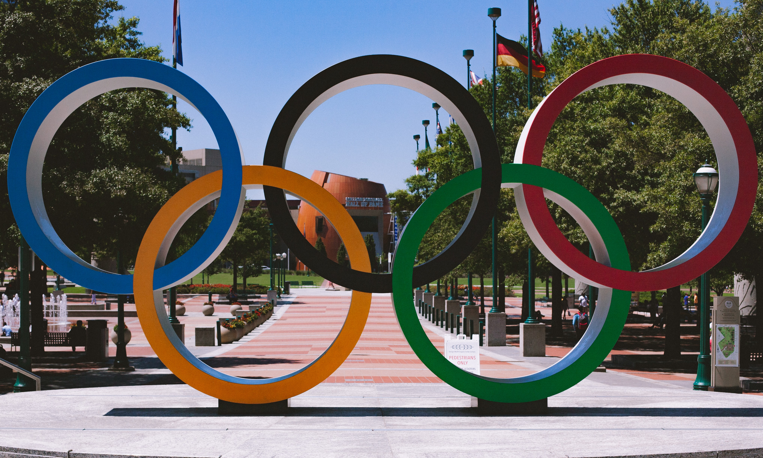
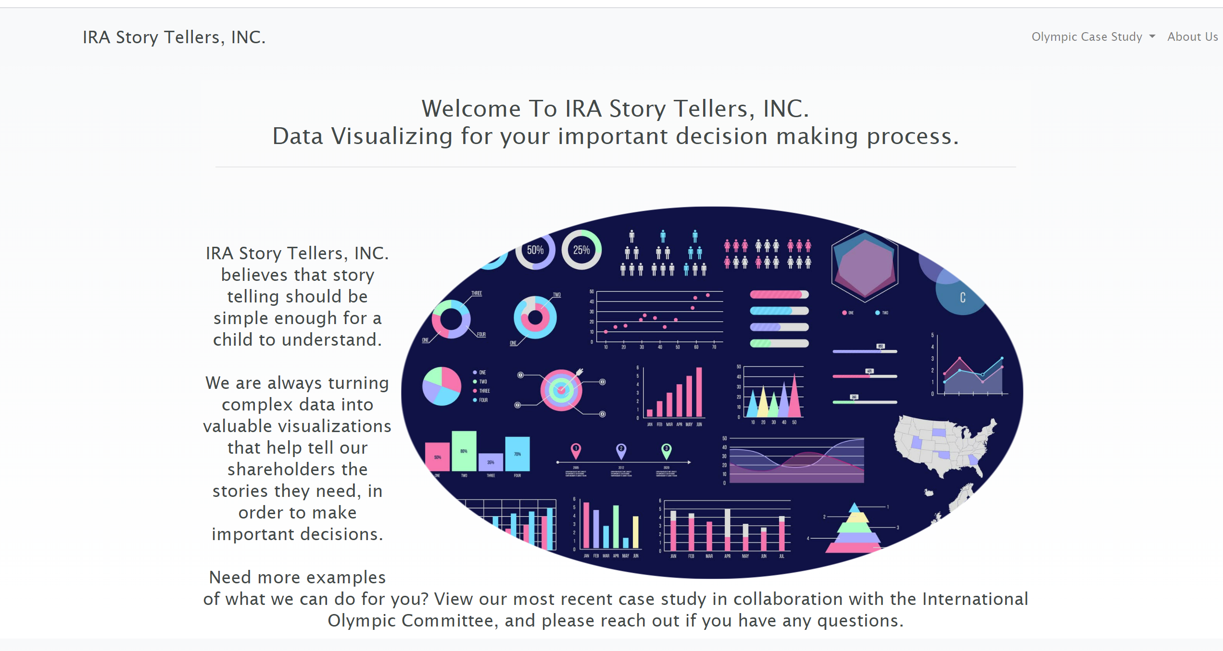

Theme ~ Olympic case Study
Story telling with Data ~ IRA Story Tellers, Inc
Data Visualizing for important decision-making
~ Project Background
~ Topic Selection
~ Data Set Selection Process
~ Inspiration

Slide 4
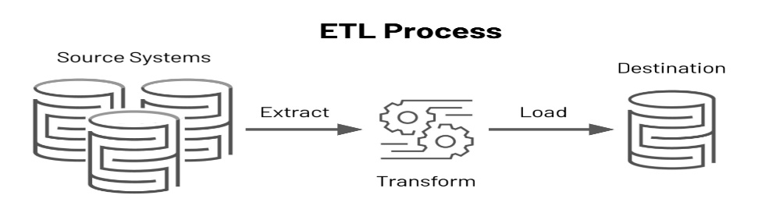

Coding Approach
The power in Visualizations
Finding Data
Three Data Sources: Kaggle & Data World
This is a pre-ETL stage that involves data research and screening, as well as developing a project proposal.
Extract Data
CVS Files
Extracted CSV files were inspected to identify possible flaws including different column titles, labelling format, and dates.
Transform Data
Data Frames
Created a Medals Data Frame and split Data Frame to three using groupby function by medal categories: Gold, Silver, and Bronze.
Load Data
Initialized engine to connect to postgress (pgAdmin) and checked for tables using engine.table_names().
ERD Depicting Tables
On Jupyter, dependencies (Pandas, NumPy and SQL Alchemy) were imported dependencies.
Additional columns for medals count were inserted. To convert data to integers NaN values were replaced by zero(0) and columns were then changed to (int) data type.
Medals and athletes' tables were merged. Columns were filtered, renamed and formatted. Columns with empty rows and duplicate insertions were dropped.
The two cost Data Frames’ columns were filtered and renamed. Duplicates were dropped, Standardized NaN values. Merged the two cost Data Frames based on year and city.
Through pgAdmin, we created tables, loaded data and joined them to get the relevant columns to our question. This database was chosen because the Olympics is a very structured event, and we believed that a relational database would be the best way to load the data. The data was structured in a way, that there were many common columns that we could use to merge the data together.

Slide 5



Data Munging Techniques
Databases and Tools Utilized
Data Munging Techniques
Databases and Tools
Visualization Tools
Python Flask
SQL
SQLite
Pandas
API
HTML/CSS
Bootstrap
JavaScript
Leaflet
Plotly

Slide 6
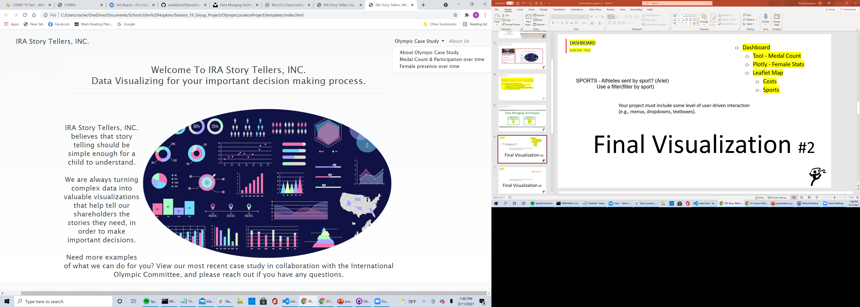


Dashboard
Interactive user experience
Interactive User Experience
Menus
Dropdowns
Textboxes
Dashboard

Slide 7
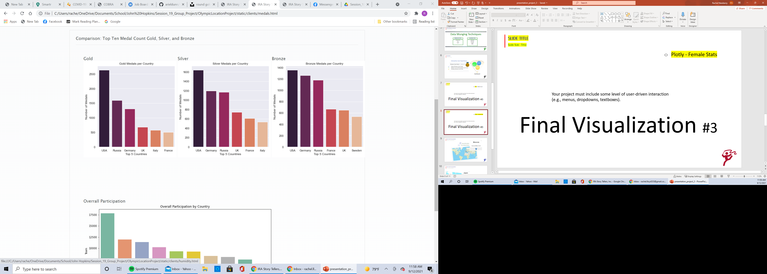
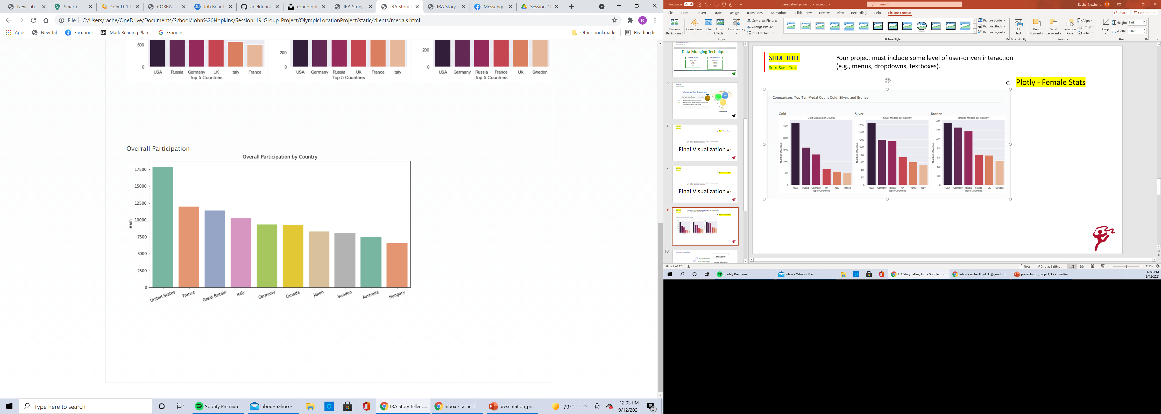
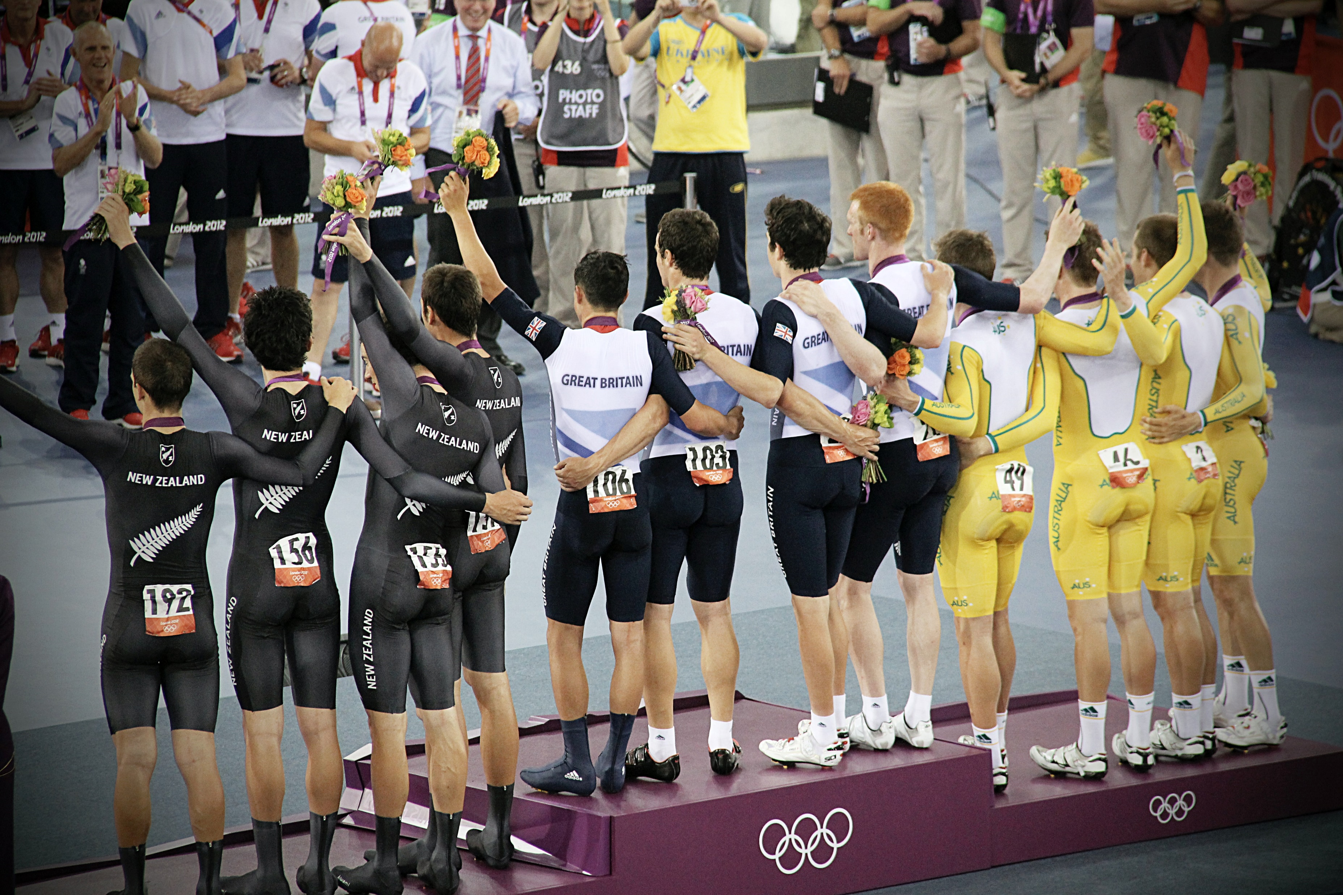
plotly ~ Bar charts
Medal count

Slide 8
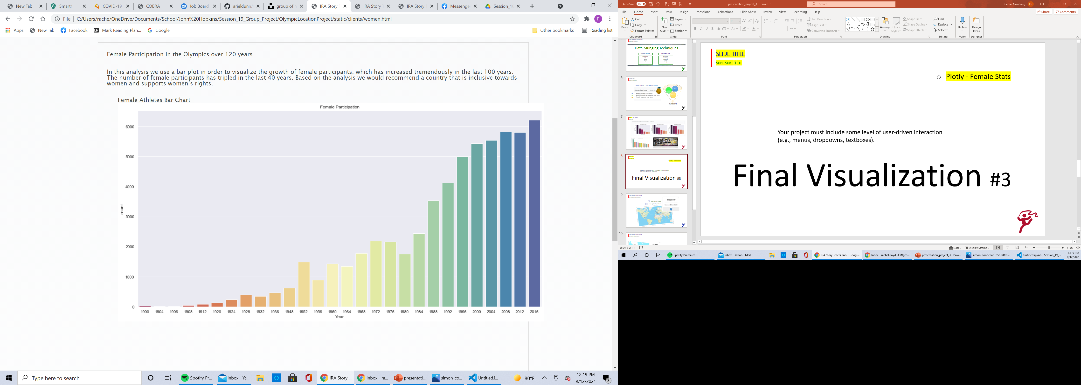
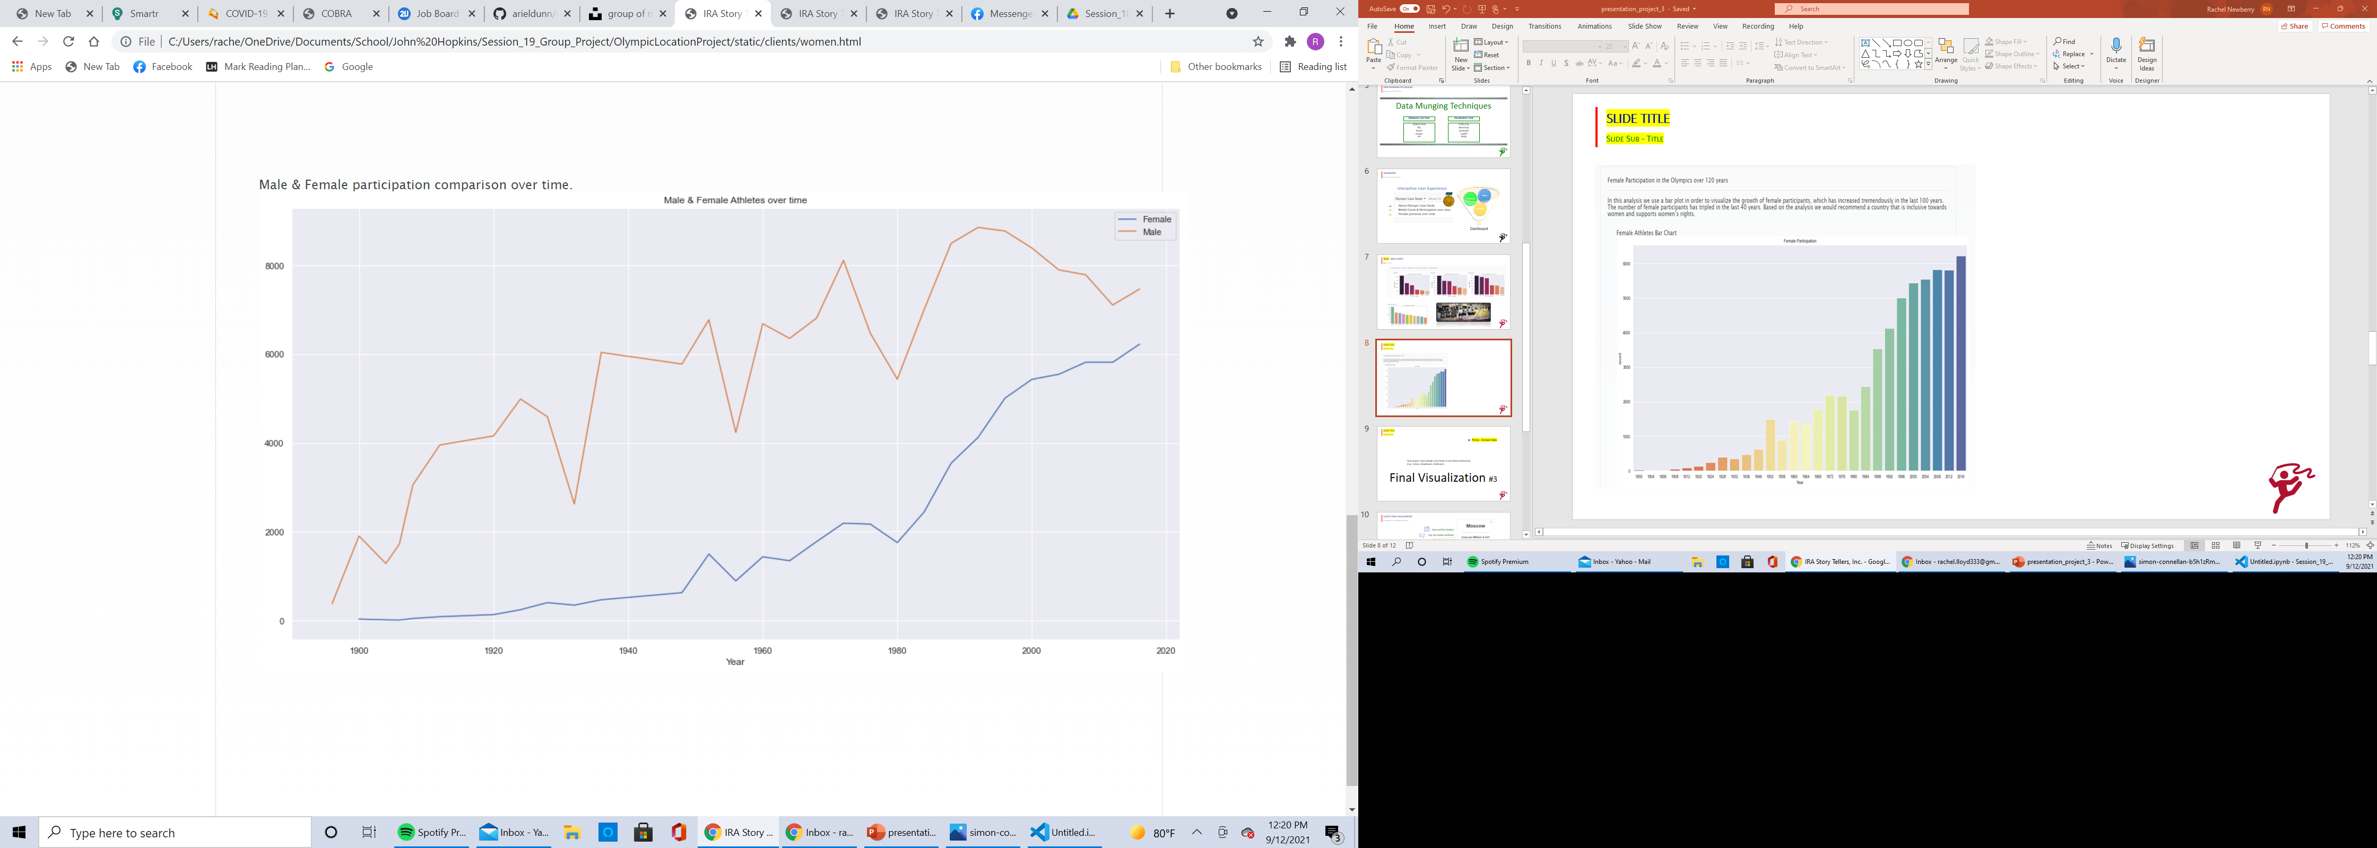
Plotly
Female participation stats

Slide 9
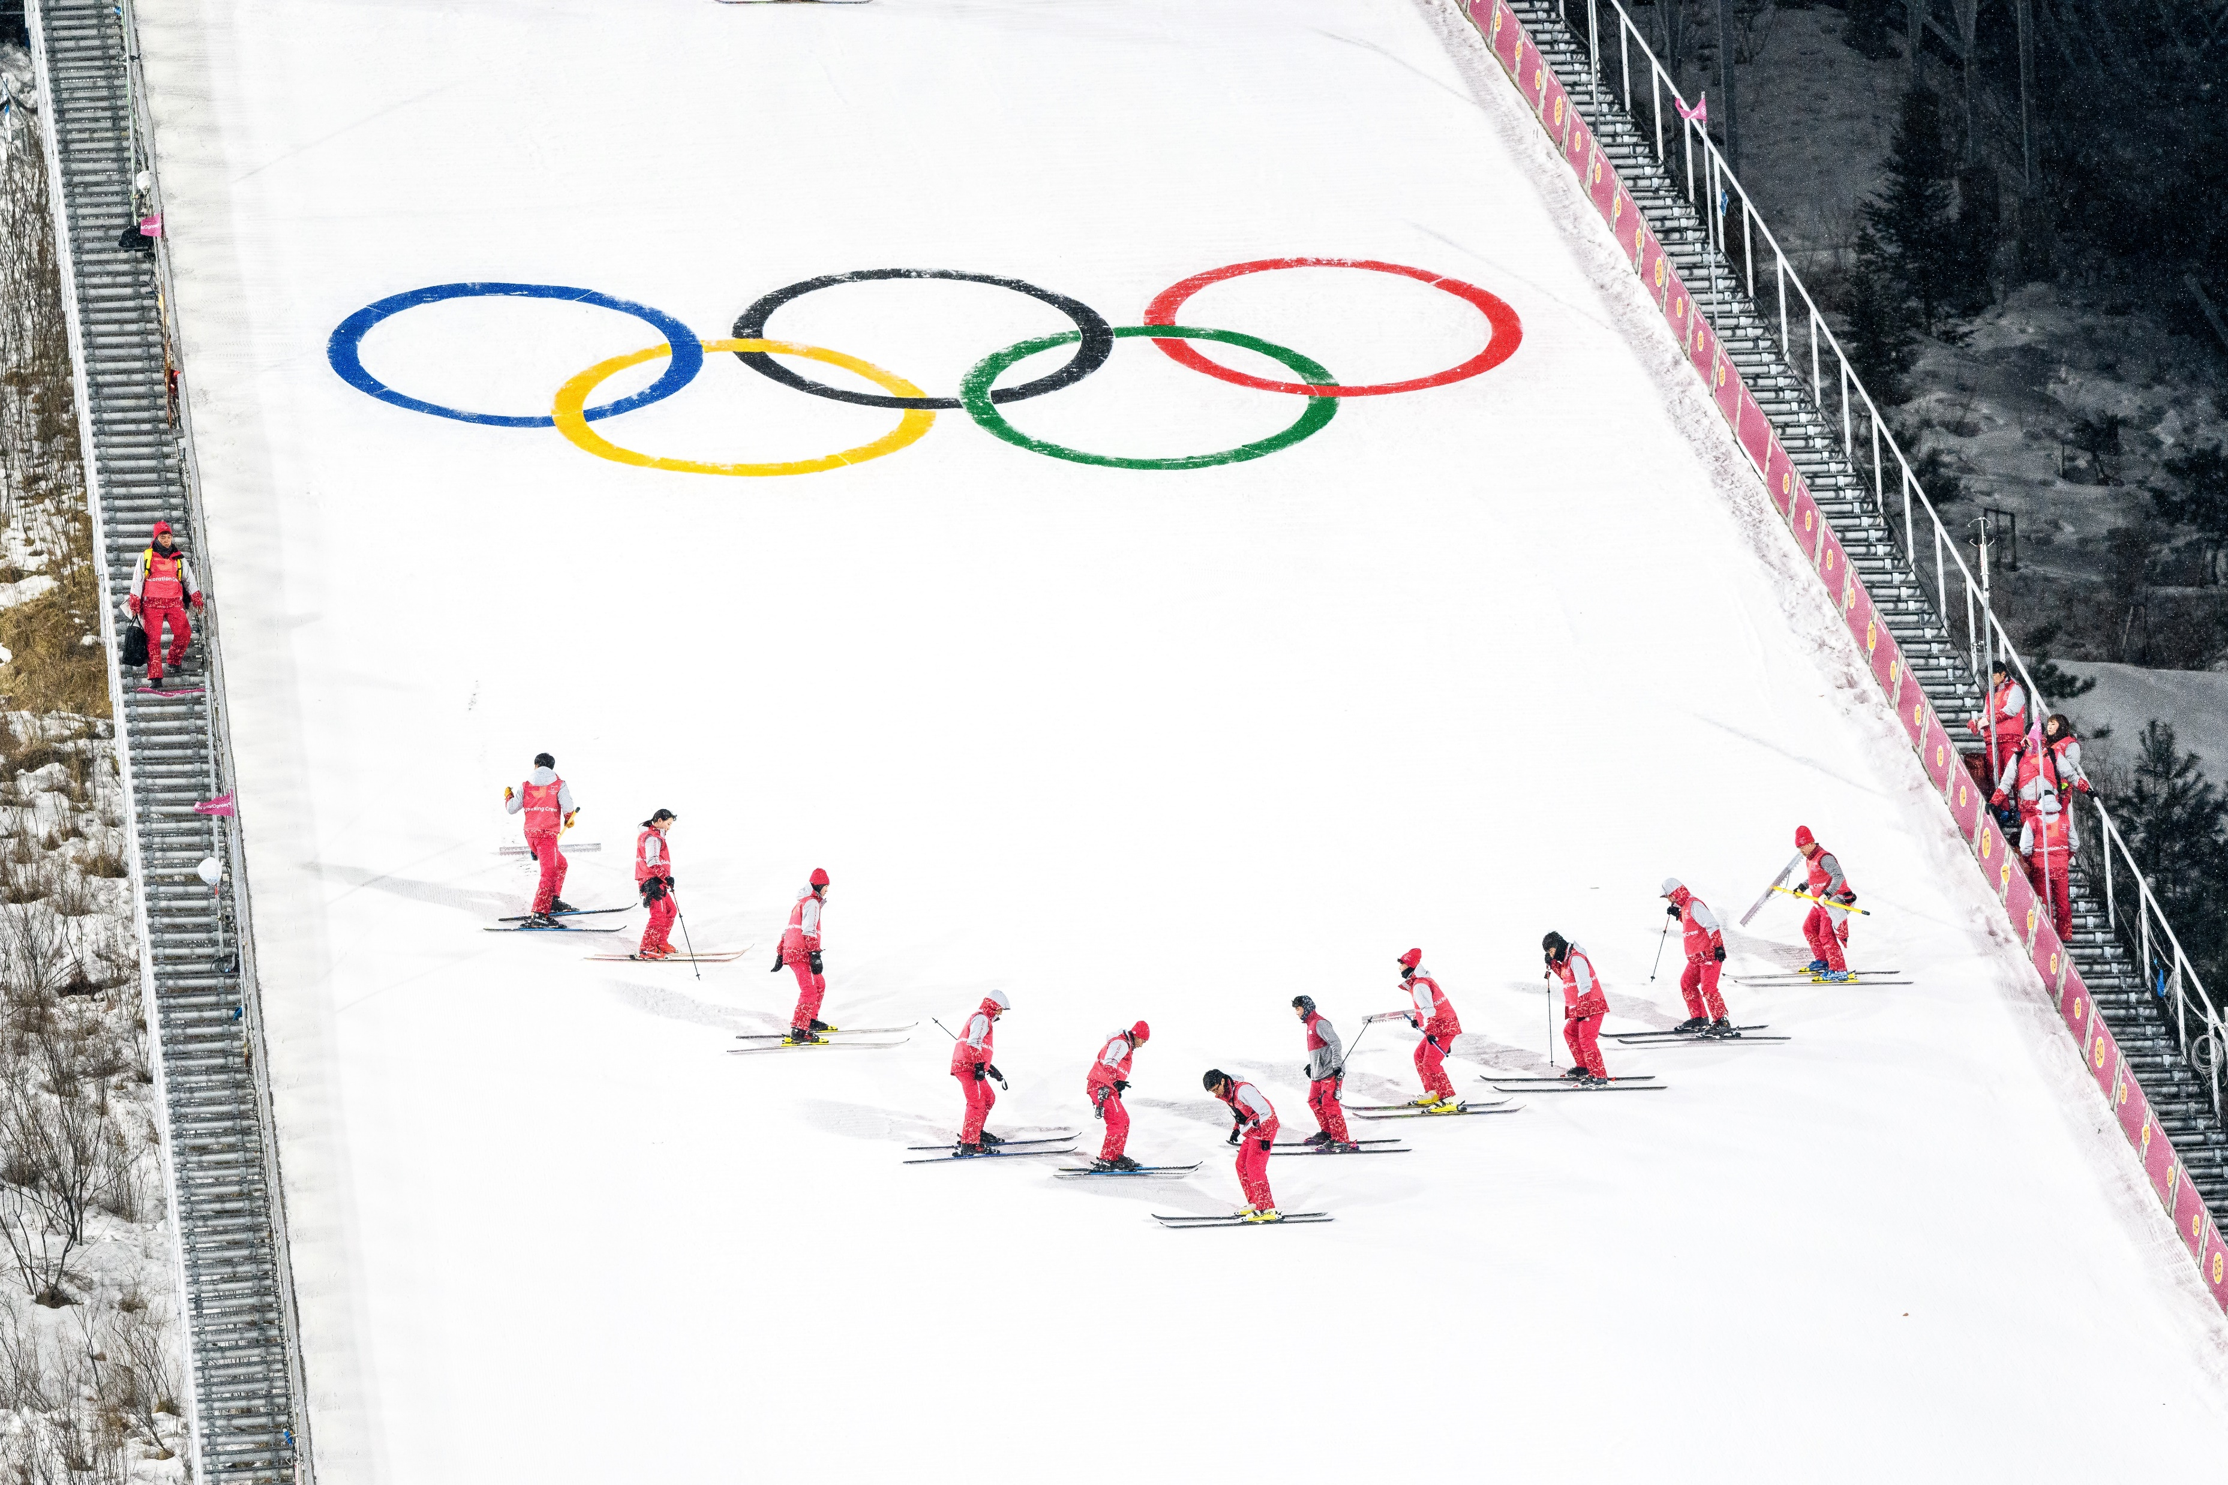

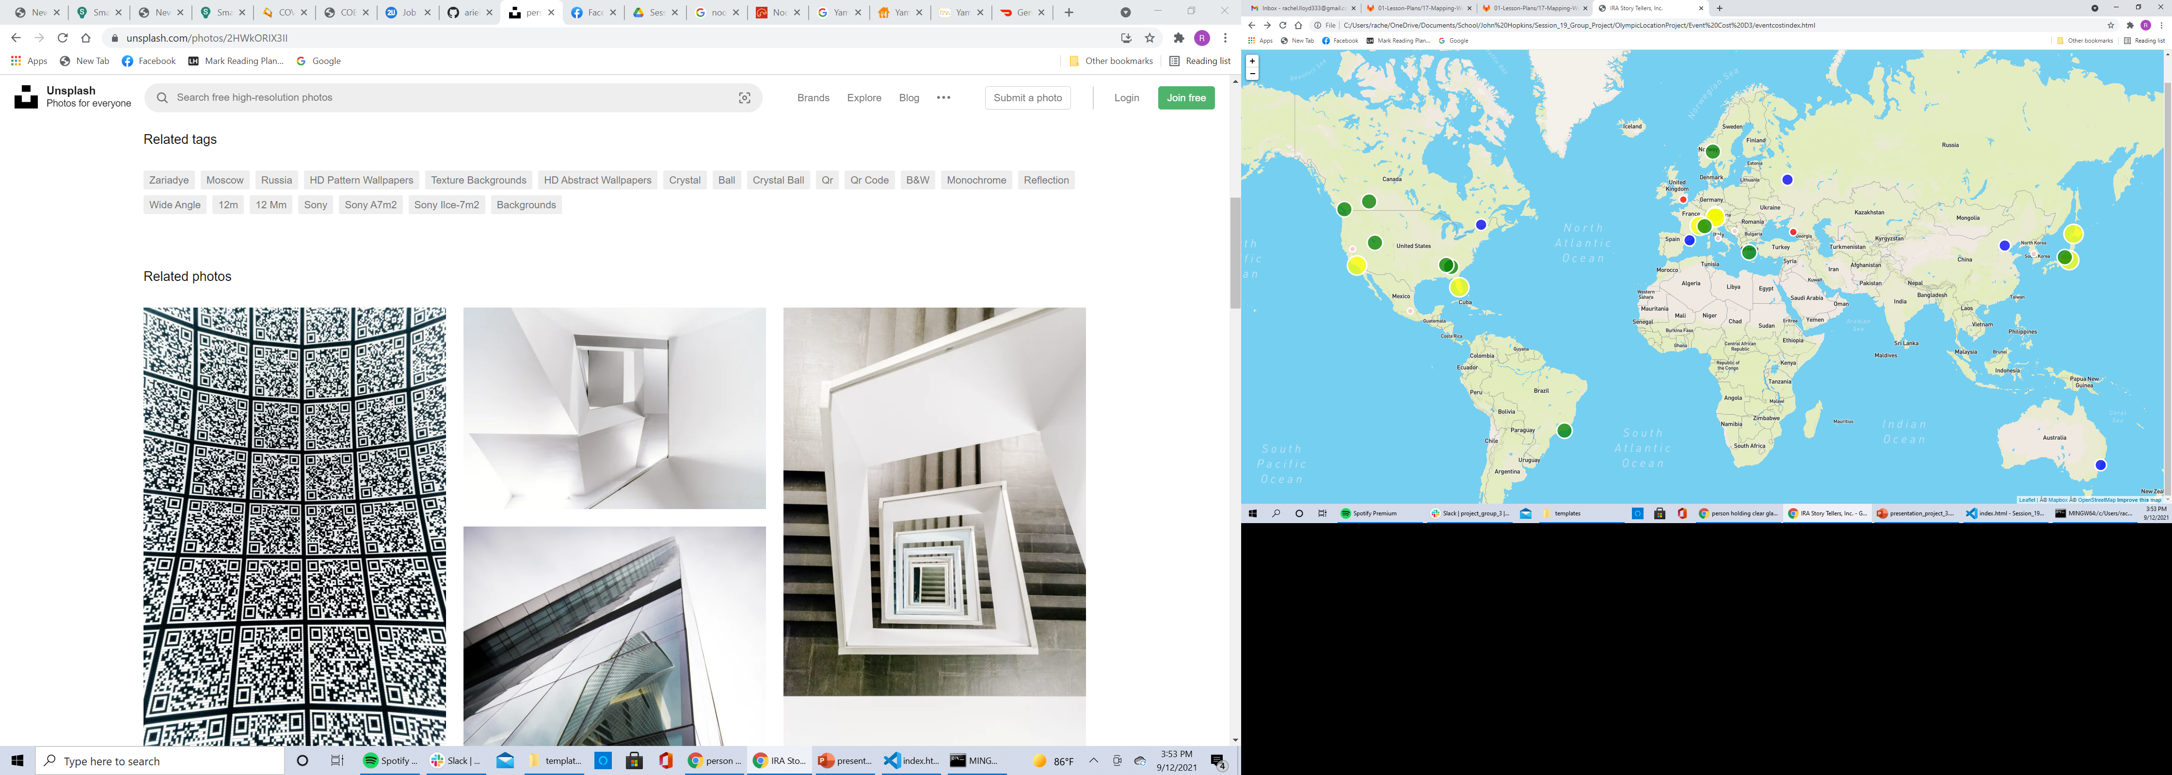
Leaflet Map Visualization
Cost, year, and Event of Olympics
Map and Circle Vectors
Pop-Up Display Textboxes

Slide 10
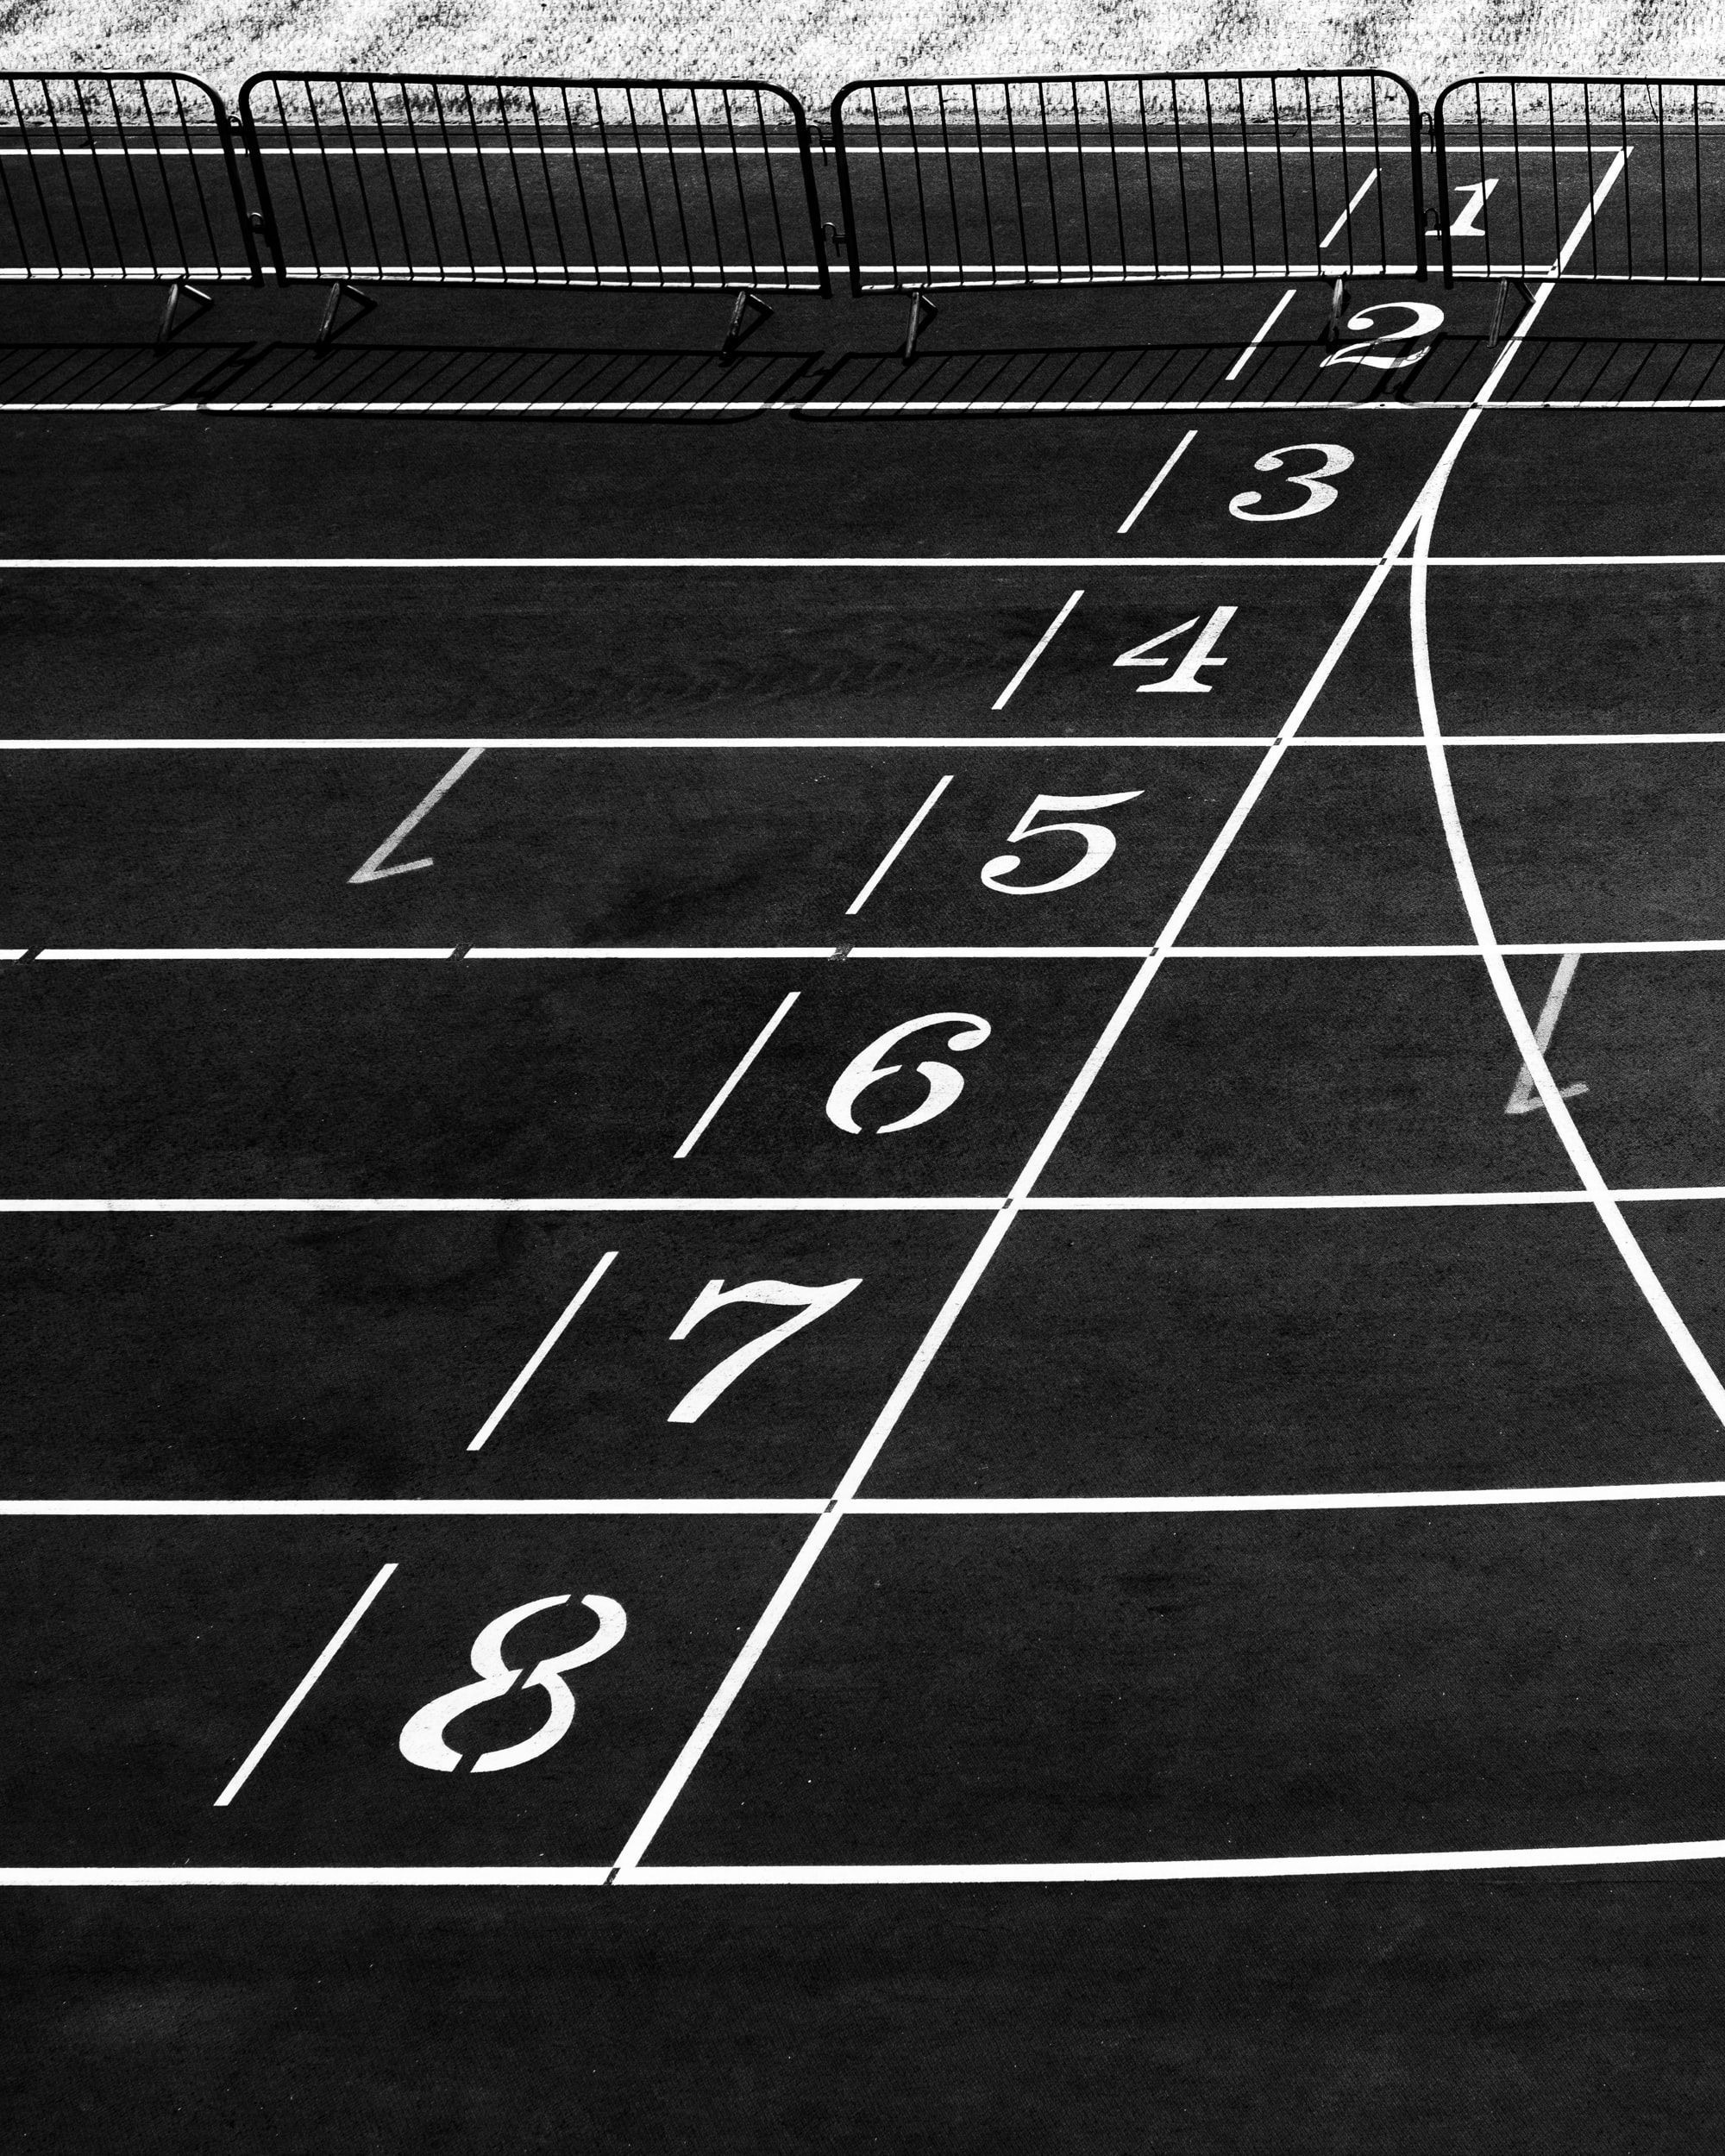
Questions
Data empowered

